Slide 1
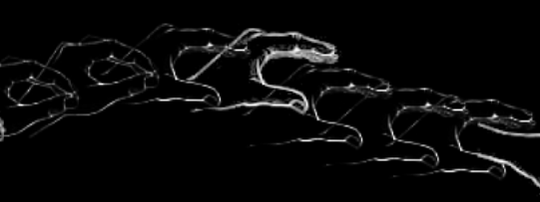
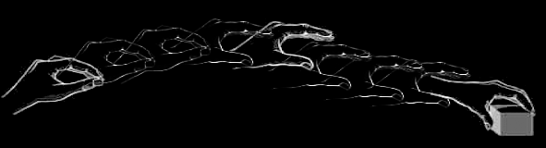
change nappy
plans
prepare infant
prepare nappy
assemble
goals
strip clothes
clean bum
open
place under
close studs
… /reach X/ /grasp X/ /grasp Y/ /pull Y/ /scoop X/ /Y out of X/ …
motor action
… [reach-left-hand X] [left-wholehand-grasp X] [right-wholehand-grasp …
motion
Image adapted from: Rizzolatti, Giacomo, and Giuseppe Luppino. 2001. The Cortical Motor System. Neuron 31, no. 6 (September 27): 889-901. doi:10.1016/S0896-6273(01)00423-8.

Slide 2
change nappy
plans
prepare infant
prepare nappy
assemble
goals
strip clothes
clean bum
open
place under
close studs
… /reach X/ /grasp X/ /grasp Y/ /pull Y/ /scoop X/ /Y out of X/ …
motor action
… [reach-left-hand X] [left-wholehand-grasp X] [right-wholehand-grasp …
motor emulation
motion
Image adapted from: Rizzolatti, Giacomo, and Giuseppe Luppino. 2001. The Cortical Motor System. Neuron 31, no. 6 (September 27): 889-901. doi:10.1016/S0896-6273(01)00423-8.

Slide 3
change nappy
plans
prepare infant
prepare nappy
assemble
goals
strip clothes
clean bum
open
place under
close studs
sequential probabilities
… /reach X/ /grasp X/ /grasp Y/ /pull Y/ /scoop X/ /Y out of X/ …
motor action
… [reach-left-hand X] [left-wholehand-grasp X] [right-wholehand-grasp …
motor emulation
motion
Image adapted from: Rizzolatti, Giacomo, and Giuseppe Luppino. 2001. The Cortical Motor System. Neuron 31, no. 6 (September 27): 889-901. doi:10.1016/S0896-6273(01)00423-8.

Slide 4
change nappy
plans
prepare infant
prepare nappy
assemble
hierarchical patterns
goals
strip clothes
clean bum
open
place under
close studs
sequential probabilities
… /reach X/ /grasp X/ /grasp Y/ /pull Y/ /scoop X/ /Y out of X/ …
motor action
… [reach-left-hand X] [left-wholehand-grasp X] [right-wholehand-grasp …
motor emulation
motion
Image adapted from: Rizzolatti, Giacomo, and Giuseppe Luppino. 2001. The Cortical Motor System. Neuron 31, no. 6 (September 27): 889-901. doi:10.1016/S0896-6273(01)00423-8.

Slide 5
change nappy
plans
prepare infant
prepare nappy
assemble
goals
strip clothes
clean bum
open
place under
close studs
object-directed actions
… /reach X/ /grasp X/ /grasp Y/ /pull Y/ /scoop X/ /Y out of X/ …
… /reach X/ /grasp X/ /grasp Y/
motor action
… [reach-left-hand X] [left-wholehand-grasp X] [right-wholehand-grasp …
motion
Image adapted from: Rizzolatti, Giacomo, and Giuseppe Luppino. 2001. The Cortical Motor System. Neuron 31, no. 6 (September 27): 889-901. doi:10.1016/S0896-6273(01)00423-8.

Slide 6
change nappy
plans
prepare infant
prepare nappy
assemble
goals
strip clothes
clean bum
open
place under
close studs
… /reach X/ /grasp X/ /grasp Y/ /pull Y/ /scoop X/ /Y out of X/ …
motor action
… [reach-left-hand X] [left-wholehand-grasp X] [right-wholehand-grasp …
motion
Image adapted from: Rizzolatti, Giacomo, and Giuseppe Luppino. 2001. The Cortical Motor System. Neuron 31, no. 6 (September 27): 889-901. doi:10.1016/S0896-6273(01)00423-8.

Slide 7


Slide 8

Your field = a set of objects related to you by proximity, orientation, lighting and other factors
You encounter an object = it is in your field
You register an object at a location = you most recently encountered the object at that location

Slide 9
Your field = a set of objects related to you by proximity, orientation, lighting and other factors
You encounter an object = it is in your field
You register an object at a location = you most recently encountered the object at that location
proximity
orientation
lighting
barriers
trajectory

Slide 10
Your field = a set of objects related to you by proximity, orientation, lighting and other factors
You encounter an object = it is in your field
You register an object at a location = you most recently encountered the object at that location
proximity
orientation
lighting
barriers
trajectory

Slide 11
Detour
Goals are not intentions

Slide 12
What is the relation between an action and the goal (or goals) to which it is directed?
out
out
act
out
out

Slide 13
What is the relation between an action and the goal (or goals) to which it is directed?
out
out
act
out
out

Slide 14
What is the relation between an action and the goal (or goals) to which it is directed?
out
out
act
out
intention or other goal-state
out

Slide 15
What is the relation between an action and the goal (or goals) to which it is directed?
teleological function
out
out
act
out
intention or other goal-state
out

Slide 16
(i) in the past, actions of this type have caused outcomes of this type; (ii) this action happens now in part because (i).
What is the relation between an action and the goal (or goals) to which it is directed?
teleological function
out
out
act
out
intention or other goal-state
out

Slide 17
(i) in the past, actions of this type have caused outcomes of this type; (ii) this action happens now in part because (i).
What is the relation between an action and the goal (or goals) to which it is directed?
teleological function
out
out
act
out
intention or other goal-state
It is possible to represent goal-directed actions without representing intentions.
out

Slide 18
End Detour

Slide 19
Your field = a set of objects related to you by proximity, orientation, lighting and other factors
You encounter an object = it is in your field
You register an object at a location = you most recently encountered the object at that location
proximity
orientation
lighting
barriers
trajectory

Slide 20
Your field = a set of objects related to you by proximity, orientation, lighting and other factors
You encounter an object = it is in your field
You register an object at a location = you most recently encountered the object at that location
Principle 3: one can’t goal-directedly act on an object unless one has encountered it.
Principle 2: correct registration is a condition of successful action.
Principle 3: when an agent performs a goal-directed action and the goal specifies an object, the agent will act as if the object were actually in the location she registers it at.
proximity
orientation
lighting
barriers
trajectory

Slide 21
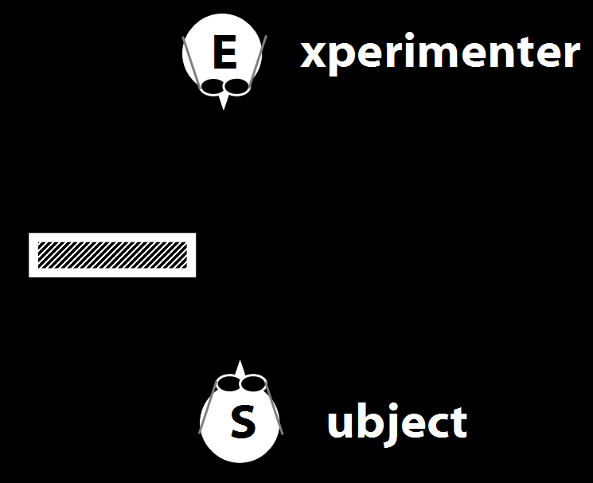
Your field = a set of objects related to you by proximity, orientation, lighting and other factors
You encounter an object = it is in your field
You register an object at a location = you most recently encountered the object at that location
Principle 3: one can’t goal-directedly act on an object unless one has encountered it.
Principle 2: correct registration is a condition of successful action.
Principle 3: when an agent performs a goal-directed action and the goal specifies an object, the agent will act as if the object were actually in the location she registers it at.
proximity
orientation
lighting
barriers
trajectory

Slide 22
Your field = a set of objects related to you by proximity, orientation, lighting and other factors
You encounter an object = it is in your field
You register an object at a location = you most recently encountered the object at that location
Principle 3: one can’t goal-directedly act on an object unless one has encountered it.
Principle 2: correct registration is a condition of successful action.
Principle 3: when an agent performs a goal-directed action and the goal specifies an object, the agent will act as if the object were actually in the location she registers it at.
“children could … think about what the other person saw rather than what they saw”
(Flavell, Shipstead & Croft 1978: 1210)
proximity
orientation
lighting
barriers
trajectory

Slide 23
Your field = a set of objects related to you by proximity, orientation, lighting and other factors
You encounter an object = it is in your field
You register an object at a location = you most recently encountered the object at that location
Principle 3: one can’t goal-directedly act on an object unless one has encountered it.
Principle 2: correct registration is a condition of successful action.
Principle 3: when an agent performs a goal-directed action and the goal specifies an object, the agent will act as if the object were actually in the location she registers it at.
“children could … think about what the other person saw rather than what they saw”
(Flavell, Shipstead & Croft 1978: 1210)
“children could … think about what the other person saw rather than what they saw”
(Flavell, Shipstead & Croft 1978: 1210)
proximity
orientation
lighting
barriers
trajectory

Slide 24
Your field = a set of objects related to you by proximity, orientation, lighting and other factors
You encounter an object = it is in your field
You register an object at a location = you most recently encountered the object at that location
Principle 3: one can’t goal-directedly act on an object unless one has encountered it.
Principle 2: correct registration is a condition of successful action.
Principle 3: when an agent performs a goal-directed action and the goal specifies an object, the agent will act as if the object were actually in the location she registers it at.
proximity
orientation
lighting
barriers
trajectory

Slide 25
Your field = a set of objects related to you by proximity, orientation, lighting and other factors
You encounter an object = it is in your field
You register an object at a location <= you most recently encountered the object at that location
Principle 3: one can’t goal-directedly act on an object unless one has encountered it.
Principle 2: correct registration is a condition of successful action.
Principle 3: when an agent performs a goal-directed action and the goal specifies an object, the agent will act as if the object were actually in the location she registers it at.
proximity
orientation
lighting
barriers
trajectory

Slide 26
Your field = a set of objects related to you by proximity, orientation, lighting and other factors
You encounter an object = it is in your field
You register an object at a location <= you most recently encountered the object at that location
Principle 3: one can’t goal-directedly act on an object unless one has encountered it.
Principle 4: correct registration is a condition of successful action.
Principle 3: when an agent performs a goal-directed action and the goal specifies an object, the agent will act as if the object were actually in the location she registers it at.
proximity
orientation
lighting
barriers
trajectory

Slide 27
source: Liszkowski et al (2008)

Slide 28
source: Liszkowski et al (2008)

Slide 29
source: Liszkowski et al (2008)

Slide 30
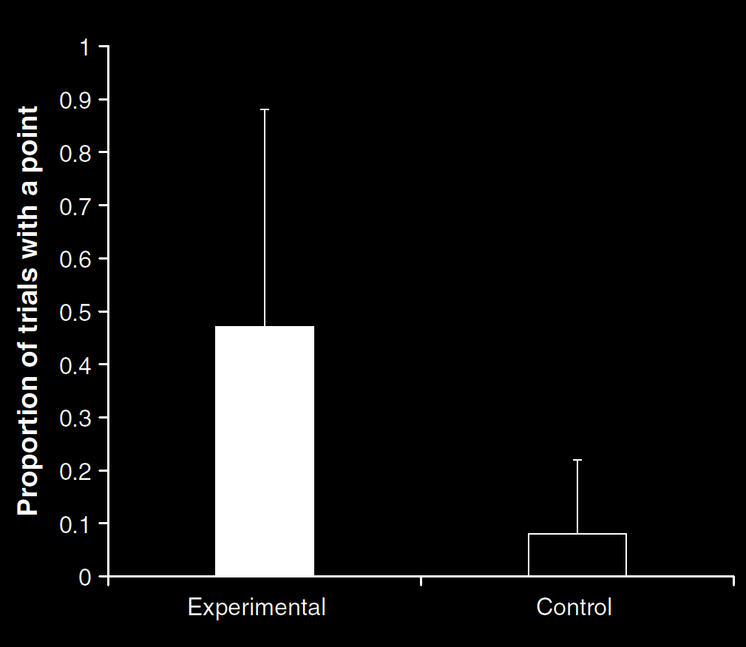
Your field = a set of objects related to you by proximity, orientation, lighting and other factors
You encounter an object = it is in your field
You register an object at a location <= you most recently encountered the object at that location
Principle 3: one can’t goal-directedly act on an object unless one has encountered it.
Principle 4: correct registration is a condition of successful action.
Principle 3: when an agent performs a goal-directed action and the goal specifies an object, the agent will act as if the object were actually in the location she registers it at.
source: Liszkowski et al (2008)
proximity
orientation
lighting
barriers
trajectory

Slide 31
source: Liszkowski et al (2008)

Slide 32
Your field = a set of objects related to you by proximity, orientation, lighting and other factors
You encounter an object = it is in your field
You register an object at a location <= you most recently encountered the object at that location
Principle 3: one can’t goal-directedly act on an object unless one has encountered it.
Principle 4: correct registration is a condition of successful action.
Principle 3: when an agent performs a goal-directed action and the goal specifies an object, the agent will act as if the object were actually in the location she registers it at.
source: Liszkowski et al (2008)
proximity
orientation
lighting
barriers
trajectory

Slide 33
Your field = a set of objects related to you by proximity, orientation, lighting and other factors
You encounter an object = it is in your field
You register an object at a location = you most recently encountered the object at that location
Principle 3: one can’t goal-directedly act on an object unless one has encountered it.
Principle 4: correct registration is a condition of successful action.
Principle 3: when an agent performs a goal-directed action and the goal specifies an object, the agent will act as if the object were actually in the location she registers it at.
“Helping by informing inextricably involves … an understanding of others’ goals and … of others’ ignorance.”
(Liszkowski, Carpenter & Tomasello 2008: 738-9)
source: Liszkowski et al (2008)
proximity
orientation
lighting
barriers
trajectory

Slide 34
Your field = a set of objects related to you by proximity, orientation, lighting and other factors
You encounter an object = it is in your field
You register an object at a location = you most recently encountered the object at that location
Principle 3: one can’t goal-directedly act on an object unless one has encountered it.
Principle 4: correct registration is a condition of successful action.
Principle 3: when an agent performs a goal-directed action and the goal specifies an object, the agent will act as if the object were actually in the location she registers it at.
“Helping by informing inextricably involves … an understanding of others’ goals and … of others’ ignorance.”
(Liszkowski, Carpenter & Tomasello 2008: 738-9)
“Helping by informing inextricably involves … an understanding of others’ goals and … of others’ ignorance.”
(Liszkowski, Carpenter & Tomasello 2008: 738-9)
source: Liszkowski et al (2008)
proximity
orientation
lighting
barriers
trajectory

Slide 35
Your field = a set of objects related to you by proximity, orientation, lighting and other factors
You encounter an object = it is in your field
You register an object at a location <= you most recently encountered the object at that location
Principle 3: one can’t goal-directedly act on an object unless one has encountered it.
Principle 4: correct registration is a condition of successful action.
Principle 3: when an agent performs a goal-directed action and the goal specifies an object, the agent will act as if the object were actually in the location she registers it at.
proximity
orientation
lighting
barriers
trajectory

Slide 36
Your field = a set of objects related to you by proximity, orientation, lighting and other factors
You encounter an object = it is in your field
You register an object at a location <= you most recently encountered the object at that location
Principle 3: one can’t goal-directedly act on an object unless one has encountered it.
Principle 4: correct registration is a condition of successful action.
Principle 5
proximity
orientation
lighting
barriers
trajectory

Slide 37
Your field = a set of objects related to you by proximity, orientation, lighting and other factors
You encounter an object = it is in your field
You register an object at a location <= you most recently encountered the object at that location
Principle 3: one can’t goal-directedly act on an object unless one has encountered it.
Principle 4: correct registration is a condition of successful action.
Principle 5: when an agent performs a goal-directed action and the goal specifies an object, the agent will act as if the object were actually in the location she registers it at.
proximity
orientation
lighting
barriers
trajectory

Slide 38
puzzle
What could infants, chimps and scrub-jays represent that would enable them, within limits, to track others’ perceptions, knowledge, beliefs and other propositional attitudes?

Slide 39


